Slide 1
CyberShield AI Machine Learning-Based Network Intrusion Detection System
CAPSTONE PROJECT
Presented By:
Student Name-Anwesha Sural
College Name-Netaji Subhash Engineering College
Department Computer Science and Engineering
4. aicte id: STU67684b82678951734888322

Slide 2
OUTLINE
Problem Statement
Proposed System/Solution
System Development Approach
Algorithm & Deployment
Result
Conclusion
Future Scope
References

Slide 3
Problem Statement
Modern computer networks are continuously exposed to cyberattacks and unauthorized access attempts. Manually monitoring large volumes of network traffic is difficult, time-consuming, and prone to errors.
Traditional security systems may fail to identify new or complex intrusion patterns efficiently. Therefore, an intelligent system is required to analyze network traffic data and distinguish normal network activity from malicious or anomalous activity.
The objective is to develop a machine learning-based Network Intrusion Detection System capable of identifying suspicious traffic and supporting early detection of cyber threats.

Slide 4
Proposed Solution
CyberShield AI – Network Intrusion Detection System
The proposed solution uses machine learning to classify network traffic as Normal or Anomaly.
Main components
Dataset Collection: Use a Network Intrusion Detection dataset containing normal and malicious network traffic records.
Data Upload: Upload the training dataset to IBM watsonx.ai as a data asset.
Data Preprocessing: Process numerical and categorical features such as protocol type, service, flag, source bytes, destination bytes, and connection statistics.
Model Training: Use IBM watsonx.ai AutoAI to generate and compare multiple machine learning pipelines.
Best Model Selection: Select the pipeline with the highest cross-validation performance.
Model Deployment: Deploy the trained model as an online deployment using IBM watsonx.ai Runtime.
Frontend Integration: Connect a Streamlit application to the IBM deployment API.
Prediction: Allow users to upload test CSV data and receive Normal or Anomaly predictions.

Slide 5
System Approach
System Requirements
Hardware Requirements
Computer or laptop
Stable internet connection
Minimum 4 GB RAM
Software and Services
Python
IBM Cloud Lite
IBM watsonx.ai
IBM watsonx.ai AutoAI
IBM watsonx.ai Runtime
Visual Studio Code
Streamlit
Python Libraries
Streamlit
Pandas
Requests
python-dotenv
System Workflow
Dataset → IBM watsonx.ai AutoAI → Model Training → Best Pipeline → Online Deployment → REST API → Streamlit Frontend → Prediction Output

Slide 6
Algorithm & Deployment
Algorithm Selection
IBM watsonx.ai AutoAI generated eight machine learning pipelines and compared them using cross-validation performance.
The best-performing model was:
Algorithm: Snap Decision Tree Classifier
Prediction Type: Binary Classification
Target Column: class
Classes: Normal and Anomaly
Accuracy: 0.995 or 99.5%
Data Input
The model uses network traffic features such as:
Duration, protocol_type, service, flag, src bytes , dst bytes, connection and host-related statistics
Training Process
Uploaded Train_data.csv to IBM watsonx.ai
Selected class as the prediction column
Disabled time-series analysis
Ran the AutoAI experiment
Compared eight generated pipelines
Selected the highest-ranked pipeline
Deployment Process
Saved the best pipeline as a model
Created a deployment space
Created an online deployment
Generated a secured public REST API endpoint
Connected the endpoint to the Streamlit frontend

Slide 7
Result
The IBM watsonx.ai AutoAI experiment successfully generated eight machine learning pipelines.
Final Results
Best Model: Snap Decision Tree Classifier
Cross-Validation Accuracy: 0.995
Output Classes: Normal and Anomaly
Deployment Status: Online and Deployed
Frontend: Streamlit application
Input Method: CSV file upload
Prediction Output: Classification and probability values
The deployed model successfully classified test network traffic records through the Streamlit interface.

Slide 8
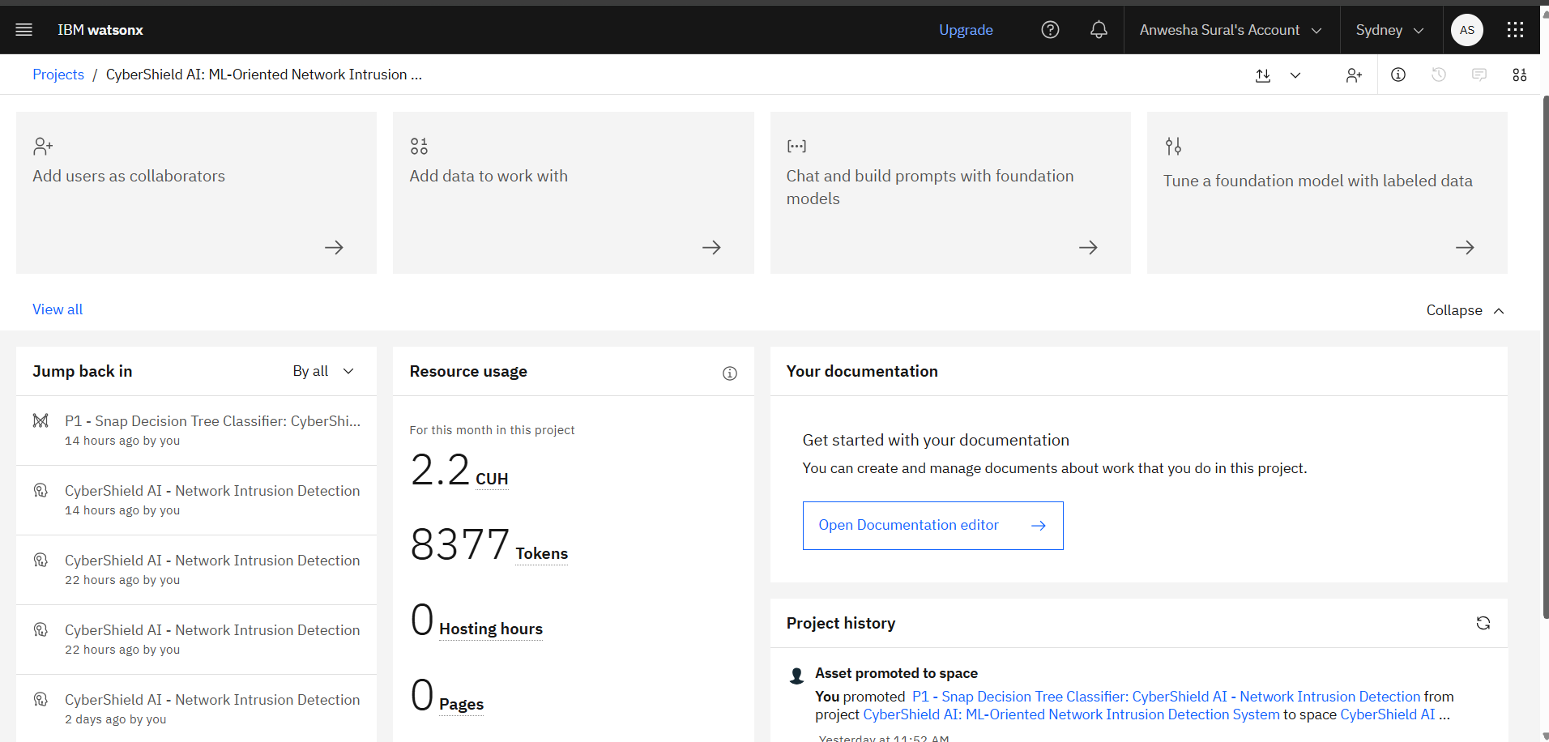
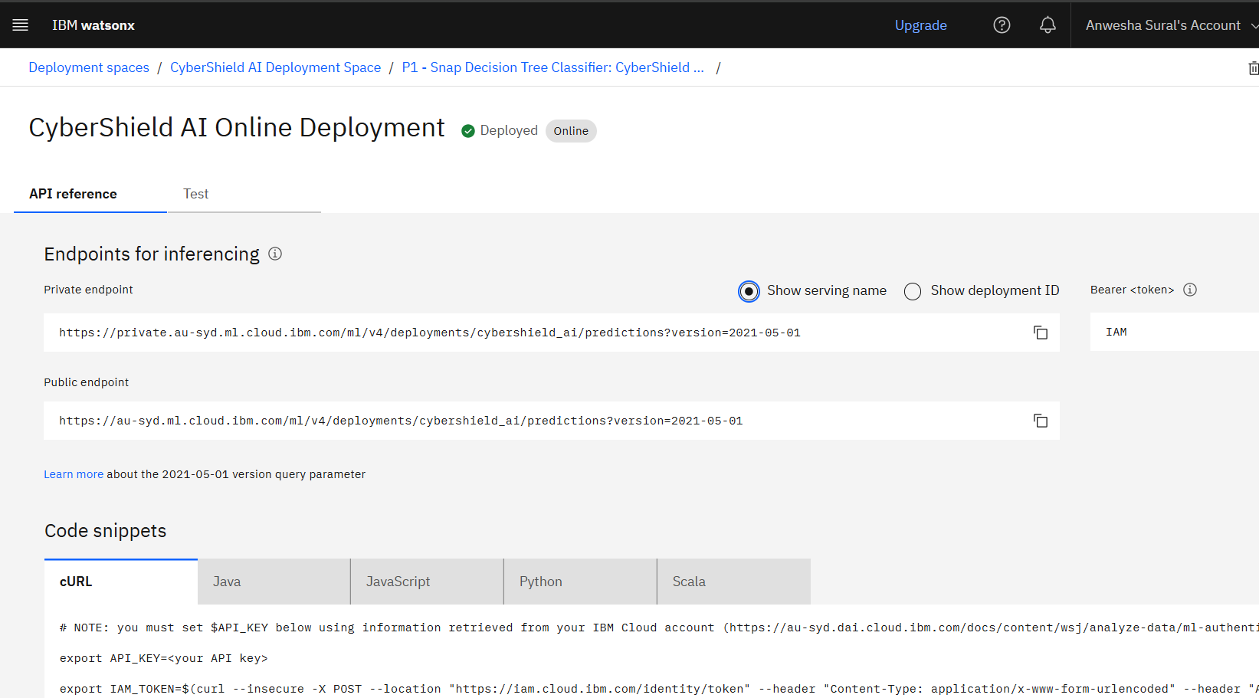
Screenshots regarding deployments

Slide 9
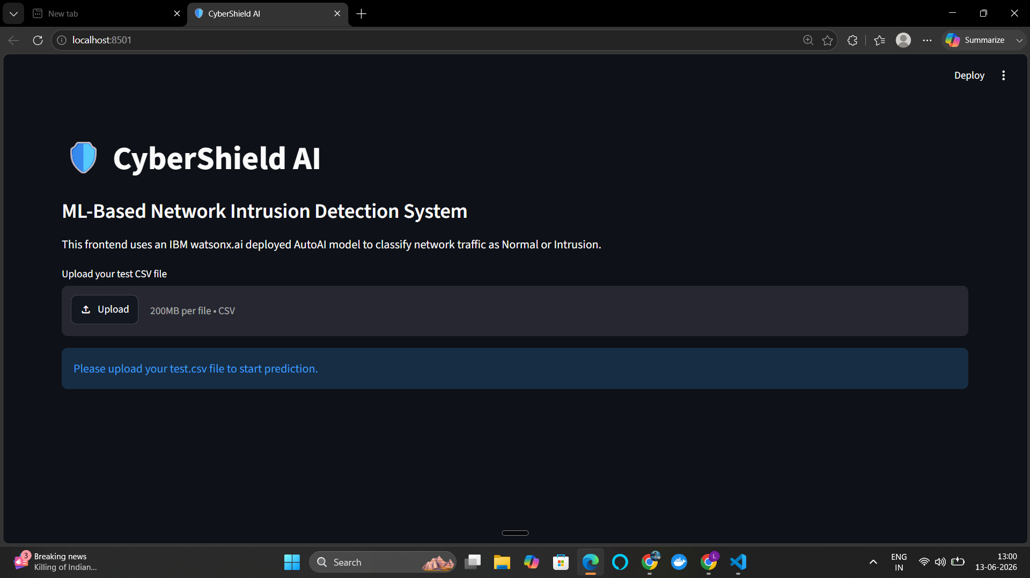
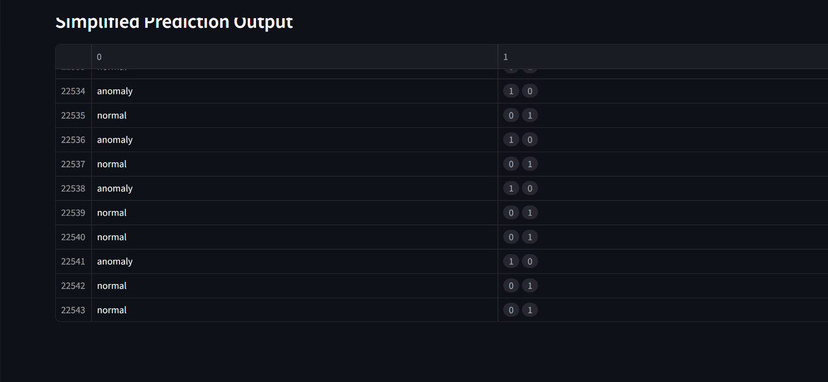
Streamlit interface

Slide 10
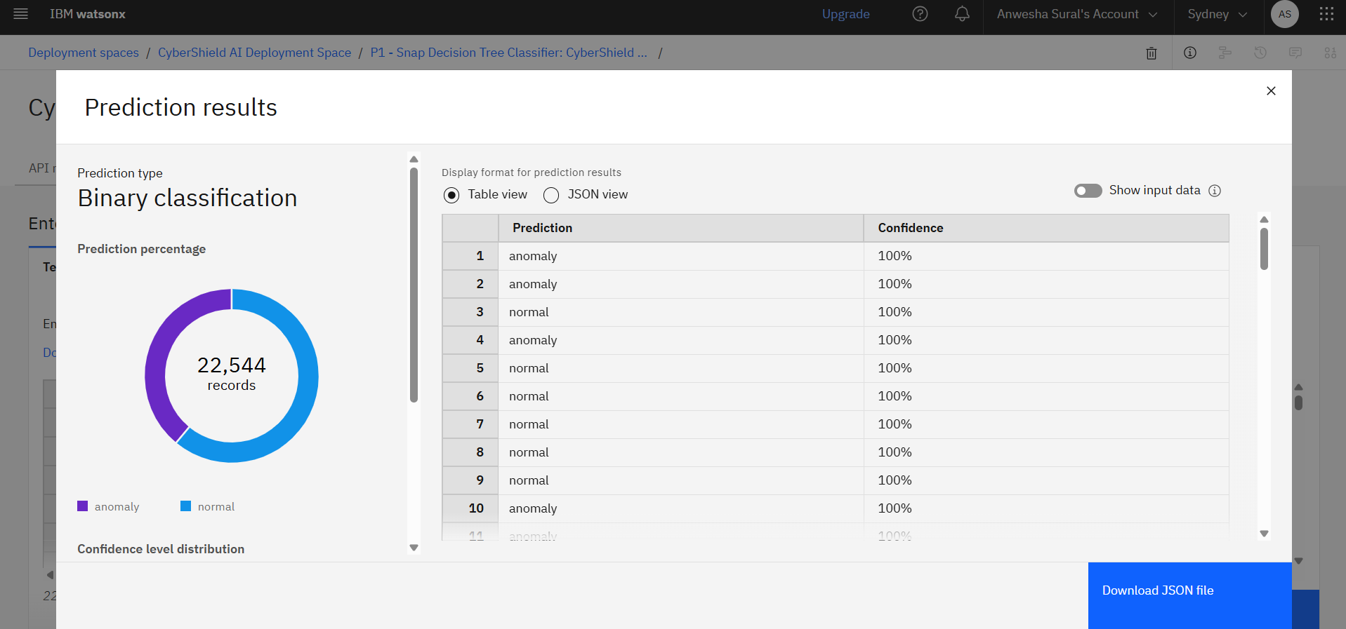
Prediction result

Slide 11
Conclusion
CyberShield AI successfully demonstrates an end-to-end machine learning solution for network intrusion detection.
The system uses IBM watsonx.ai AutoAI to train and evaluate multiple classification pipelines. The best-performing Snap Decision Tree Classifier achieved 99.5% cross-validation accuracy.
The model was deployed using IBM watsonx.ai Runtime and connected to a Streamlit frontend through a secured API endpoint. Users can upload network traffic data and receive Normal or Anomaly predictions.
The project demonstrates practical knowledge of machine learning, cybersecurity, cloud deployment, API integration, and frontend development.

Slide 12
Future scope
Real-Time Traffic Monitoring: Capture and analyze live network packets instead of relying only on uploaded CSV files.
Multi-Class Attack Detection: Classify attacks into categories such as DoS, Probe, R2L, and U2R.
Alert System: Send email, SMS, or dashboard notifications when malicious activity is detected.
Advanced Models: Test Random Forest, XGBoost, neural networks, LSTM, and hybrid deep-learning models.
Security Dashboard: Display attack counts, risk levels, prediction history, and network-security trends.
Continuous Model Retraining: Retrain the model using newly collected network traffic data.

Slide 13
References
IBM watsonx.ai Documentation
IBM watsonx.ai AutoAI Documentation
IBM Cloud Documentation
Streamlit Documentation
Python Documentation
Pandas Documentation
Kaggle Network Intrusion Detection Dataset
AICTE–IBM SkillsBuild

Slide 14
Deployment link / github link
Public GitHub Repository
https://github.com/lucia-builds/cybershield-ai-network-intrusion-detection.git
IBM Cloud Model Deployment Endpoint
https://au-syd.ml.cloud.ibm.com/ml/v4/deployments/cybershield_ai/predictions?version=2021-05-01
Repository Files
app.py
app.json
requirements.txt
README.md
.gitignore
problemstatement.pdf
projectpresentation.pptx

Slide 15
THANK YOU

